Slide 1
User Awareness & Training:
EMERGENCY
Bucharest, Romania – 8th November 2013
Agata Priolo
This presentation includes material courtesy of DG ENTR and DG JRC

Slide 2
Content
Module 1: INTRODUCTION to GIO EMS Services [40 mins]
Overview of the GIO Emergency services
  Overview of Operational Services
  Description of RUSH and Non-RUSH services workflow
  Presentation of EMS Portfolio
  Description of a typical EMS activation

Slide 3
Content – Demo and Training
Module 2: Live Demonstration: GIO Emergency services [45 mins]
Topics:
  GIO EMS Portal
  GIO EMS User Guide
  Portfolio and Products analysis
  How to access the service
Tools:
  GIO EMS Portal
  (URL: http://emergency.
    copernicus.eu/mapping/)
  Printed map package
  GIO EMS USER GUIDE
Module 3: Exercise: Scenario Analysis and Service Activation [1h, 25 mins]
Topics:
  Scenario analysis
  AOIs definition
  Products selection
  SRF compilation
Tools:
  Doc file dossier:
      Scenario description
      Service Request Form
      User Feedback Form

Slide 4

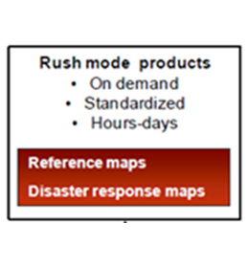
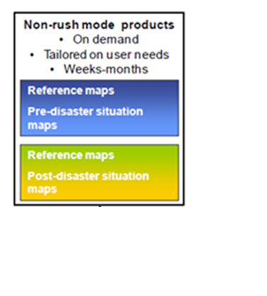
Copernicus EMS Service Overview
RUSH Service
High level of urgency
Active 24/7
NON RUSH Service
Low level of urgency
Mapping Validation

Slide 5
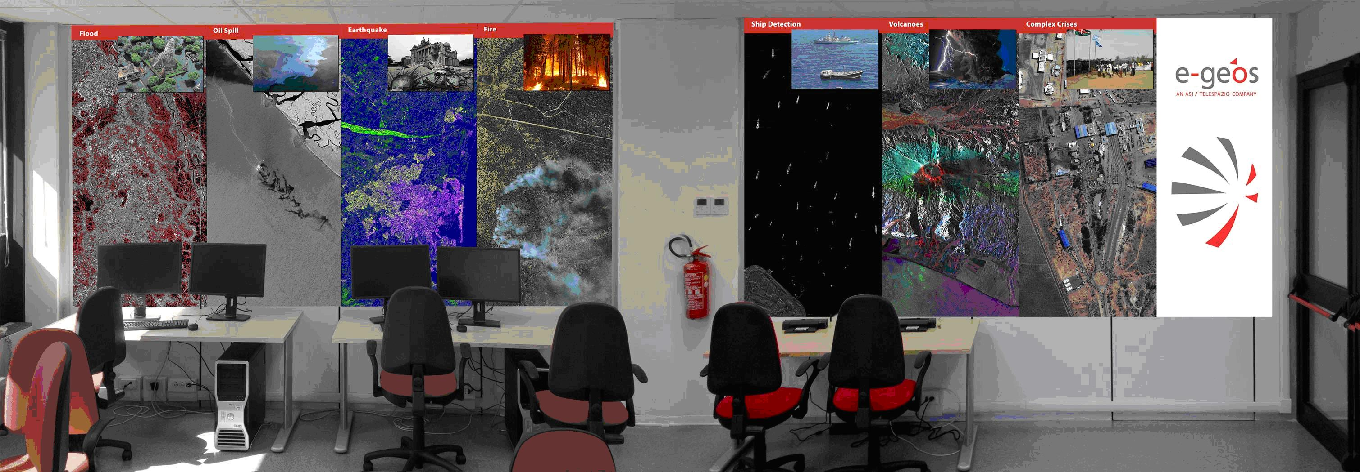
GIO EMS service
The service can be activated in…
  Floods
  Earthquakes
  Fires
  Severe Storms
  Tsunamis
  Technological disasters
  Humanitarian crises
  The generation of cartographic
  products (maps) are based on the
  use of remote sensing data:
  Optical Images
  SAR images

Slide 6
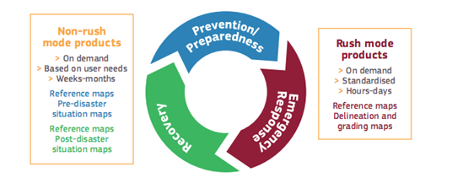
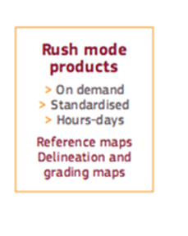
GIO EMS RUSH mode
On-demand provision of geo-spatial information based on satellite data analysis
Active H24 / 7D
Focus on Emergency response phase
Providing standardized Products

Slide 7



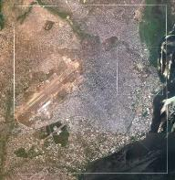
GIO EMS RUSH – Product Portfolio
Requests from users are classified in the following types:
Type 1: Reference
Type 2: Reference + Delineation
Type 3: Reference + Delineation + Grading
Base layer
Hydrology: rivers, lakes, reservoirs and open water, etc
Toponyms and administrative boundaries
Physiography: cliffs, contours and spot heights, etc
Land cover: cropland, grassland, scrub, forest, natural vegetation, bare soil, wetlands, etc
Settlements, both formal (urban, suburban, rural, etc) and informal (slums, IDP camps, etc)
Transport: all transport networks and related infrastructure (e.g. roads, tracks, trails, railways, bridges, harbours, and airfields)
Industry and Utilities: industrial facilities and power stations
Reference
Delineation
Grading
Each map type has to be provided
at two different scales:
Overview
1:25.000
1:50.000
1:100.000
1:200.000
1:500.000
Detail
1:5000
1:10.000
1:15.000
1:20.000
1:25.000

Slide 8
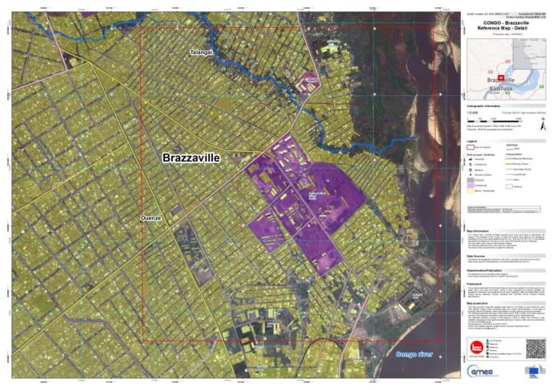
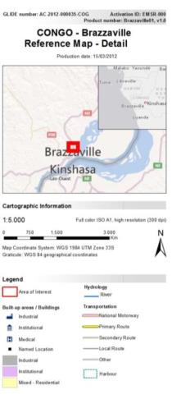

Reference Map
Pre-Event cartographic product showing:
Basic topography information (roads, land cover, hydrological features and tailored information) for pre-disaster analysis e.g. potential gathering areas, potential helicopter landing areas

Slide 9
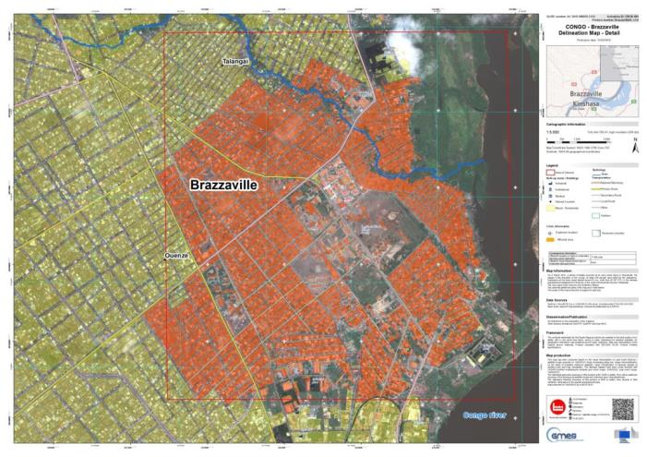
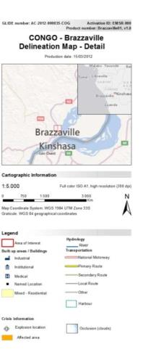
Delineation Map
Post-Event cartographic product showing:
Information on affected area (i.e. flooded area) coupled with basic topography information as per Reference Map

Slide 10
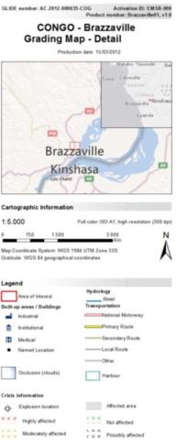
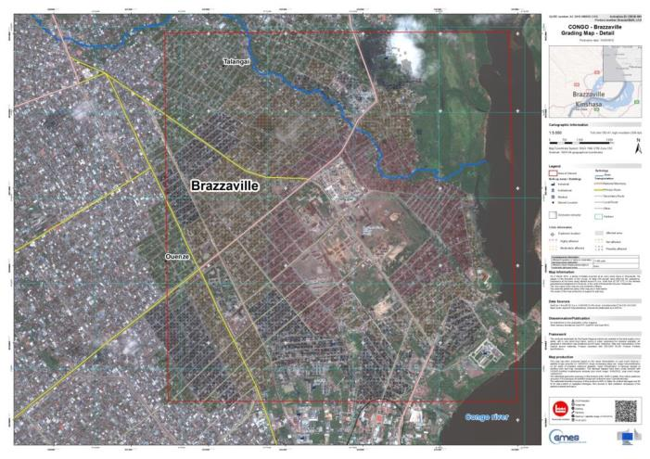
Grading Map
Post-Event cartographic product highlighting:
Effects of the event on the specific affected area and structures (i.e. level of damage, affected buildings/roads, etc.) combined with Reference & Disaster Extent Maps

Slide 11
Involved Actors during an Activiation
The Authorized Users (AU) are the main beneficiaries of the GIO-EMS services
The ERCC is the operational coordinator of the GIO EMS
The DG JRC is the technical and administrative coordinator of GIO-EMS
The ESA GSC-DA is responsible for EO data provision
The On Duty Operator (OdO) is responsible for taking charge of the activation from the trigger to the delivery and the management of the overall process of GIO-EMS RUSH service production
The Production Site (PS) takes charge of the EO data elaboration and the production of services required by the AU
Service Provider

Slide 12

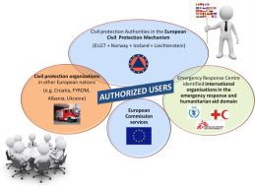





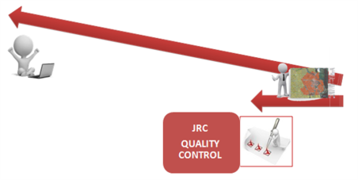
The Operational Workflow

Slide 13
Operational Workflow
1.
Service Request
Authorized User
The AU selects products and fills the Service Request Form (SRF)
Service Request authorization
ECHO ERCC
Activation Feasibility
Service Provider
ESA
2.
Satellite data tasking; provision of Satellite Resource Table
3.
Product Relevance
Authorized User
The User checks provisional product specification and delivery plan
4.
Product Generation and Delivery
Service Provider
5.
Quality Check and feedback
Authorized User
EC JRC

Slide 14
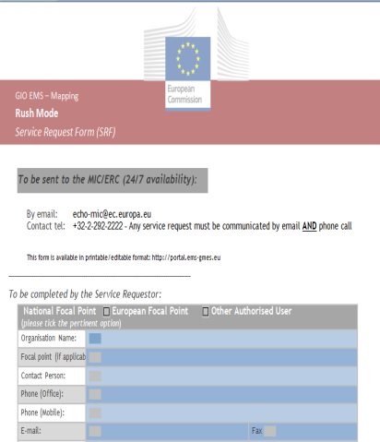

Service Request Completion
AU’s trigger the service by compiling a Service Request Form
  Editable pdf version to be sent as an e-mail attachment to ERC at: ECHO-ERCC@ec.europa.eu
  The SRF Compilation and delivery is followed up with a phone alert to ERC: +32 229 21112
Notes:
ECHO = European Community Humanitarian Office
ERCC = Emergency Response Coordination Centre

Slide 15
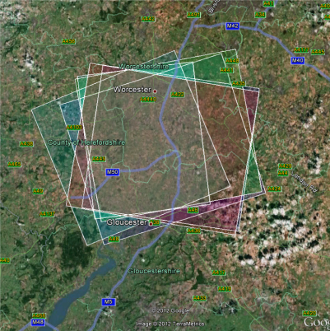
Activation Feasibility
Check the feasibility of using satellite imagery to map the event
Check the event age to assess if it is still possible to extract meaningful information
Check the event extent in order to select the most appropriate image swath/resolution
Check the level of mapping detail requested vs the extent of the event area
Check the feasibility of the requested delivery time compared to the satellite systems ‘ acquisition capabilities

Slide 16
Product Relevance
The AU checks the provisional product specification and delivery plan
On Duty Operator
Authorised User
Estimated product delivery time based on:
Satellite acquisition time
Product type
Any other additional constraints
Consistency check between the estimated product delivery time and operational constraints/ requirements of the End Users
Go / No-Go feedack
Assessment of product relevance is performed twice during the activation lifecycle:
At the time of satellite tasking (rough estimation)
After satellite data reception (more precise estimation)

Slide 17

Product Generation and Delivery
GIO-EMS mapping delivers by default, information as feature data sets
Product dissemination foresees complete set of defined deliverables (including printable maps)
The Service Provider delivers products:
    Via JRC SFTP site
    Via GIO EMS Portal
    (not-yet-quality-reviewed)
AU is alerted after upload with access details
JRC performs an offline quality review and independent “evaluation” of delivered products
Reference
Delineation
Grading

Slide 18

How the Service Works: A Typical Timeline
Event date
Triggering by authorized users
Satellite programming
Image acquisition
Map production
Factors affecting service timeliness:
User triggering delay
Satellite image availability latency
Weather conditions, when optical images are needed
T3 = T0 +
T2 + 3/8 hours
T2 = T0 +
T1 + 1/2 days
T1 = T0 + 1 day
Products Delivery to AU/ASCU
T0
EARLY WARNING SYSTEMS
Courtesy of JRC

Slide 19
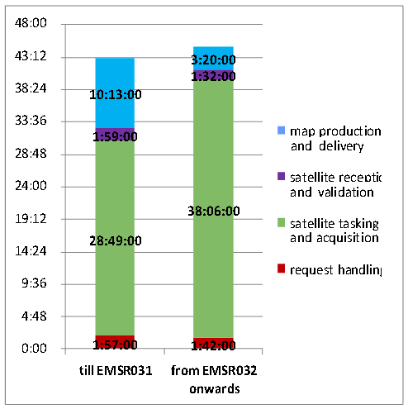

Timeline of RUSH activations
Average values observed for each main phase of an activation through the whole service provision
The duration of an activation is mostly defined by the time needed for EO data tasking and acquisition
First Available Map:
- 3hrs (flood, fire, special request)
- 8hrs (all other cases)

Slide 20
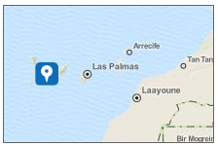
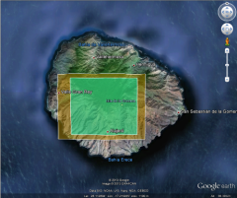
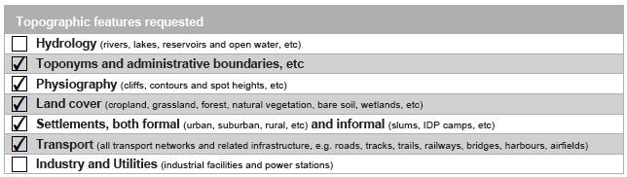
EMSR016 – A Typical Activation 1/6
Event Time (UTC): 2012-08-04 12:00
REQUEST HANDLING
Activation triggering: 14/08/2012 – 10:24 CET (T0)
Actions (GIO EMS RUSH OdO) – (Time: T0 + 1hr):
  SRF analysis and feasibility:
    AOI consistency check (dimensions vs requested scale, OVR vs DTL)
    Requested topographic features
    Event age + type → Understand if relevant information can be extracted from satellite data
  Discussion with the AU about activation details and modifications (if any)
Demanding request for topographic features, but indication for access national resources
Very useful cartographical info can be found in this webpage of the IGN (National Geographical Institute) http://www2.ign.es/iberpix/visoriberpix/visorign.html
OVR and DTL AOI are too close in extent
OVR AOI is always fully covered and analyzed, but at a lower scale
However, OVR and DTL both fit scale limits.

Slide 21
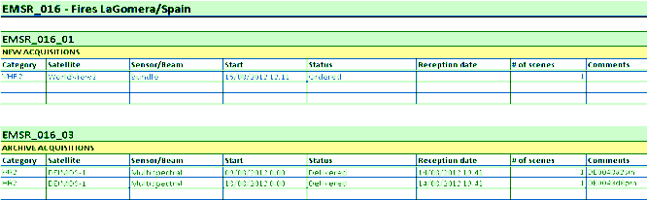
EMSR016 – A Typical Activation 2/6
SATELLITE TASKING AND ACQUISITION
  Actions (OdO + ESA) – (Time: T0 + 2hrs → T0 + 36 hrs)
    Satellite tasking forms submission (OdO → ESA) – T0+ 2hrs
    Satellite tasking plan proposal (ESA → OdO) – T0+ 10hrs
      Archive imagery → DEIMOS
      New acq. imagery → WorldView-2
    Satellite tasking plan confirmation (OdO → ESA) – T0 + 10hrs
    Satellite new acquisition / Archive delivery:
      DEIMOS: 09-13/08/2012 (from archive)
      WorldView-2: 15/08/2012 12:11 UTC
  Actions (OdO + AU) - Orthoimages from Spanish PNOA
Satellite data plan, containing information about planned satellite acquisitions and updated according to delivered satellite images.

Slide 22
EMSR016 – A Typical Activation 3/6
SATELLITE RECEPTION AND VALIDATION
  ARCHIVE
  Actions (GCM + OdO + PS) – (Time: T0 + 9hrs → T0 + 11 hrs)
    Satellite data delivery (GCM → OdO/PS) – T0 + 9hrs
    Satellite data download (PS) – T0 + 10hrs
    Satellite data quality validation (PS) – T0 + 11hrs
  POST EVENT
  Actions (GCM + OdO + PS) – (Time: T0 + 36hrs → T0 + 49 hrs)
    Satellite data delivery (GCM → OdO/PS) – T0 + 47hrs
    Satellite data download (PS) – T0 + 48hrs
    Satellite data quality validation (PS) – T0 + 49hrs
Notes:
GCM = GMES Controll Mission

Slide 23
EMSR016 – A Typical Activation 4/6
MAP PRODUCTION AND DELIVERY
  REFERENCE MAP
  Actions (PS) – (Time: T0 + 8hrs → T0 + 20 hrs)
    Archive reference image geometric correction
    Requested topographic feature extraction
    Map layout compilation
    QC
  DELINEATION / GRADING MAP
  Actions (PS) – (Time: T0 + 49hrs → T0 + 58 hrs)
    Post event image geometric correction (respect to reference)
    Damage assessment information extraction
    Map layout compilation
    QC

Slide 24
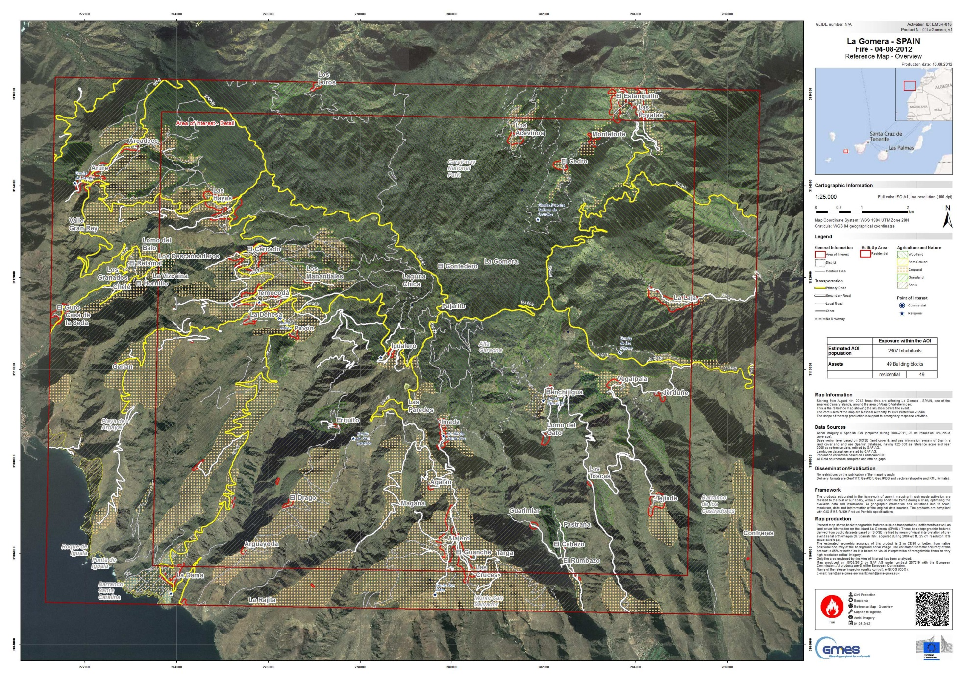
EMSR016 – A Typical Activation 5/6
La Gomera – Reference Map Overview

Slide 25
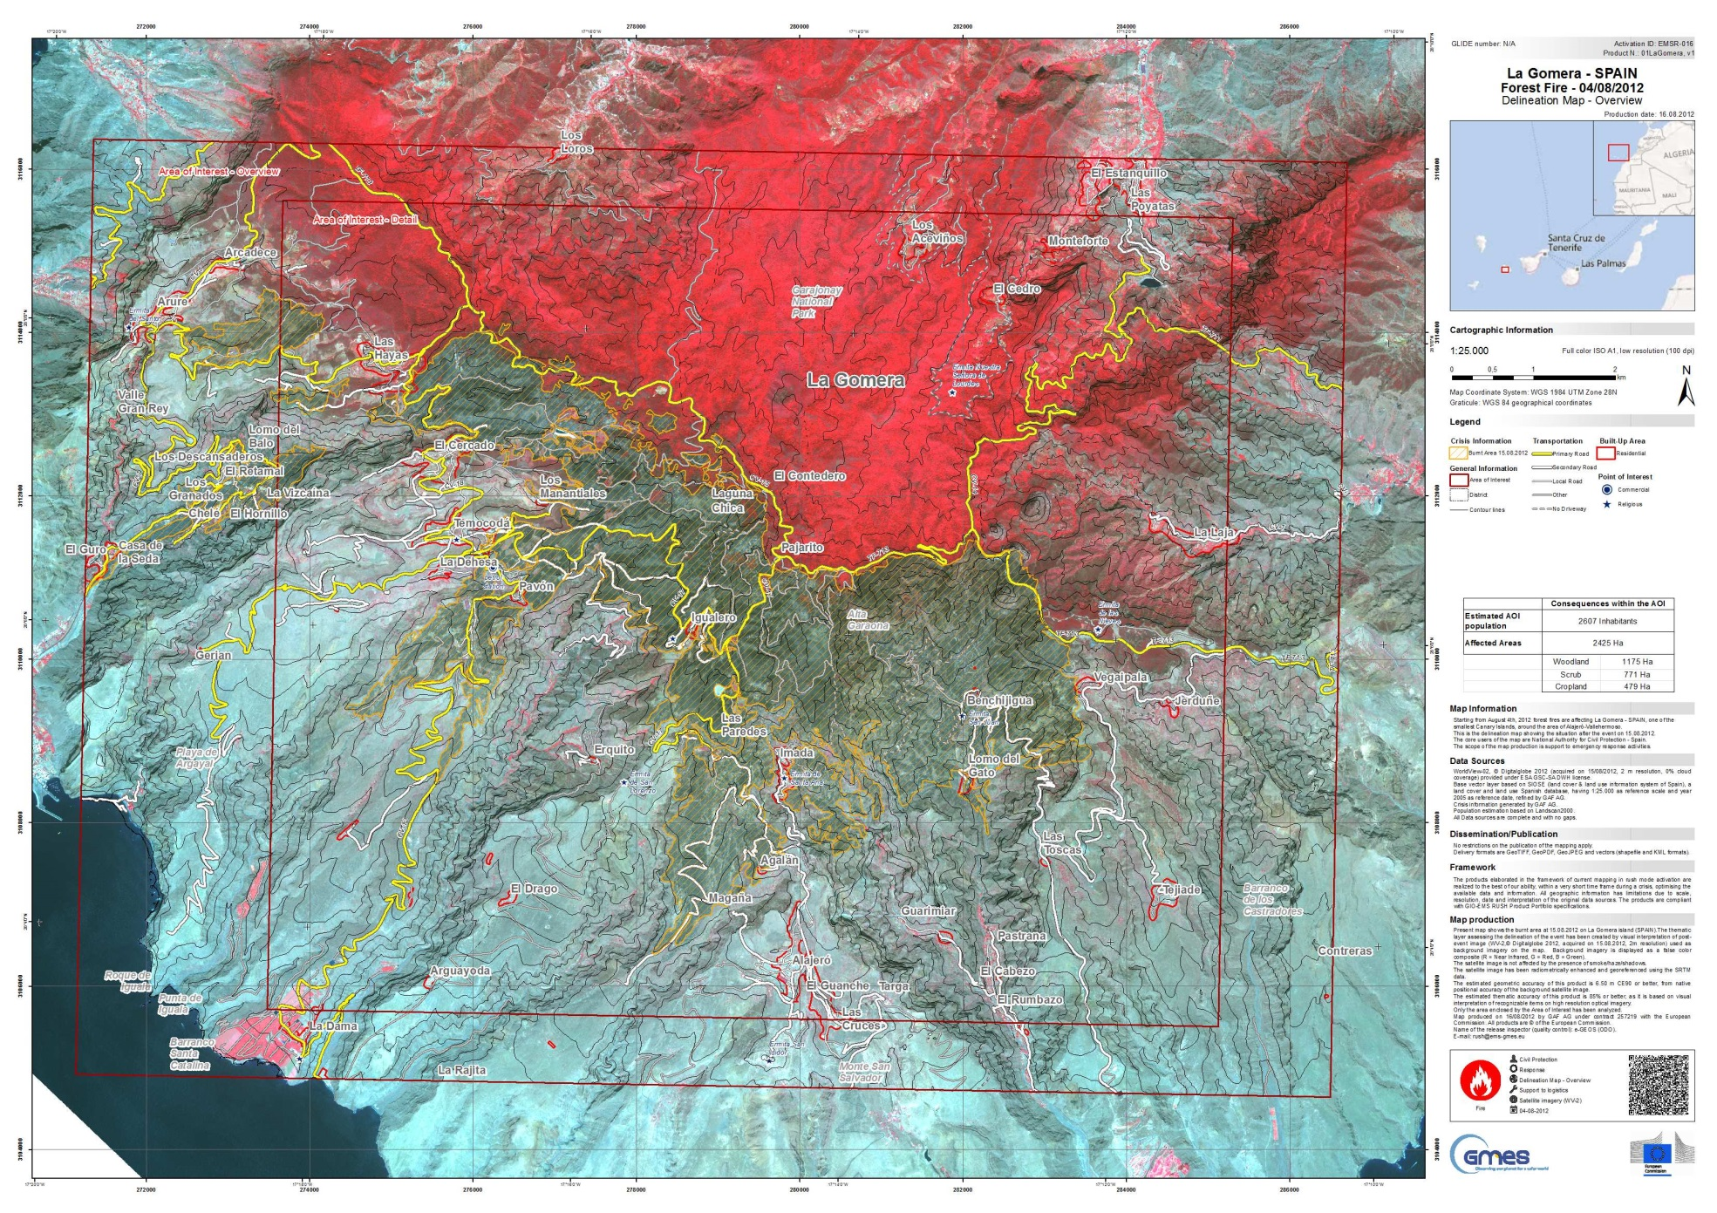
EMSR016 – A Typical Activation 6/6
La Gomera – Delineation Map Overview

Slide 26
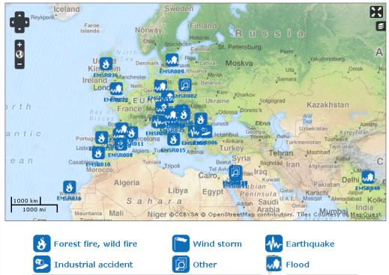
GIO RUSH Activations
 | 2012 |  |  |  |  |  |  |  |  | 2013
 | April | May | June | July | Aug | Sept | Oct | Nov | dec | Jan | Feb | March | April | May | June | July | Aug | Sept | Oct | Nov | DEC
No. activations | 1 | 3 | 2 | 6 | 5 | 1 | 0 | 3 | 0 | 4 | 2 | 3 | 10 | 2 | 6 | 2 | 0 | 0 | 2
No. Maps | 21 | 53 | 10 | 60 | 43 | 10 | 0 | 33 | 0 | 32 | 7 | 16 | 67 | 16 | 148 | 14 | 0 | 0 | 26
 | TOT. ACTIVATIONS (April 2012 – Oct 2013) | 51
Event type | FLOOD | 37%
 | FIRE | 18%
 | EARTHQUAKE | 4%
 | INDUSTRIAL | 4%
 | OTHER | 37%
TRIGGERING ENTITIES
MS Civil | 69%
MIC | 27%
JRC | 4%

Slide 27
GIO RUSH Activations
Inside Europe
Outside Europe
COUNTRIES (EC) | NUMBER OF ACTIVATIONS | EVENT TYPE | TRIGGERING ENTITIES
Poland | 1 | EURO-2012 | MS Civil
Hunagry | 2 | Fire, Flood | MS Civil
Italy | 5 | Earthquake, Fire, Landslide, Flood | MS Civil
Bulgaria | 2 | Earthquake, Industrial accident | MS Civil
Spain | 4 | Fire, Flood | MS Civil
Sweden | 1 | Flood | MS Civil
Portugal | 2 | Fire | MS Civil
Romania | 1 | Fire | MS Civil
Slovenia | 2 | Flood | MS Civil
United Kingdom | 2 | Flood, Fire | MS Civil
Croatia | 1 | Flood | MS Civil
Netherland | 1 | Coronation | MS Civil
Germany | 2 | Flood | MS Civil
Czech Republic | 1 | Flood | MS Civil
France | 1 | Flood | MS Civil
COUNTRIES (NOT EC) | NUMBER OF ACTIVATIONS | EVENT TYPE | TRIGGERING ENTITIES
Myanmar | 2 | Refugees camp | MIC
Jordan | 6 | Refugees camp | MS Civil (5), MIC (1)
Congo | 1 | Refugees camp | MIC
Turkey | 1 | Refugees camp | MIC
Lebanon | 1 | Refugees camp | MIC
Syria | 3 | Refugees camp | MS Civil, MIC, JRC
Philippines | 1 | Flood
Niger | 1 | Flood | MIC
Cameroon | 1 | Flood | JRC
Madagascar | 1 | Industrial accident | MIC
India | 2 | River bed detection, Flood | MS Civil, MIC
Bangladesh | 1 | Tropical Cyclone | MIC
Mozambique | 1 | Flood | MIC
Cambodia | 1 | Flood | MIC

Slide 28

Operational Functional Contacts
The ECHO duty officers
Mail: ECHO-ERCC@ec.europa.eu
Phone: +32 229 21112
The Geospatial Emergency Management TEAM
Mail: gio-ems-rush@jrc.ec.europa.eu
After the activation receipt and authorization from MIC
The GIO EMS TEAM on duty operator
Mail: rush@ems-gmes.eu
WEB: http://emergency.copernicus.eu/mapping Phone: +39 06 4069 4500

Slide 29
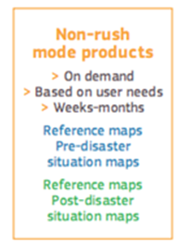
GIO EMS Non-RUSH mode
On-demand provision of geo-spatial information based on satellite data analysis
Responding to similar event types as RUSH mode but in a different time frame:
  Focus on preparedness and post-response phase (non-critical time and delivery requirements)
Tailored products designed to satisfy various specific user needs

Slide 30




The Operational Workflow
EMSN TENDER

Slide 31

Service Timeline Parameters
  Target delivery time: 8 weeks (RUSH: hours to days, 3h, 24h)
Service availability for requests: 10 hours / 5 working days (RUSH: 24 hours / 7 days)
Tender for contract
Competition between 3 Qualified consortia of Service Providers
  Based on best financial and technical offer criteria
Service delivery time: normally 30 calendar days (from service contract)
Quality Check by JRC

Slide 32
Involved Actors
The Authorized Users (AU) are the main beneficiaries of the GIO-EMS services
The ERCC is the operational coordinator of the GIO EMS
    The DG JRC is the technical and administrative coordinator of GIO-EMS – Responsible of Tender calls for mapping activations
The ESA GSC-DAP is responsible for EO data provision
Service Providers
Service Providers (SPs)
  Bid in tenders
  EO data elaboration and production
  Map delivery to JRC for Quality Check
  Updating maps in case of JRC request

Slide 33

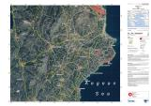
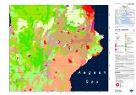
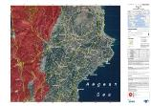
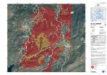
Service Portfolio
Product types:
Reference
Reference Maps
Pre-disaster Situation Maps
Reference Maps
Pre-Disaster
Post-disaster Situation Maps
Technical Specification:
Overview maps
  Scale 1:25.000 – 1:500.000
  Area approx. 200 – 100.000 km²
Detail maps
  Scale 1:5.000 – 1:25.000
  Area approx. 10 – 200 km²
Reference
Post-Disaster

Slide 34
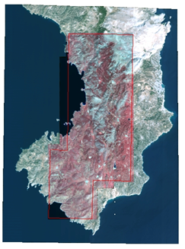
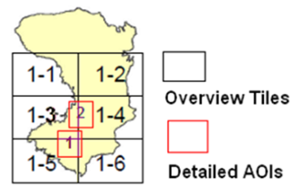
EMSN-001: a Non-RUSH Activation 1/5
USER: Greek Emergency Planning and Response Service, Ministry of Citizen Protection/General Secretariat for Civil Protection
OBJECTIVES: Determination of the impact of a wild forest
fire that occurred in the island of Chios (Greece)
DISASTER EVENT: Large fire occurred on August 18th, 2012
Severity: Fire burned large areas of high forest and shrub land
Heavy environmental and economical damages: unique
specie of Pistacia lentiscus var. Chia, cultivated for centuries, providing strong contribution to island’s economy, were mostly burnt
REQUESTED MAPS:
OVERVIEW at the 1:25k scale
DETAILED over the 2 AOIs at the 1:15k scale
Reference maps
Delineation/Grading maps
Land cover/land use maps with identification of the Pistacia lentiscus var. Chia

Slide 35
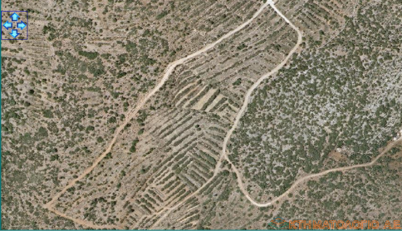
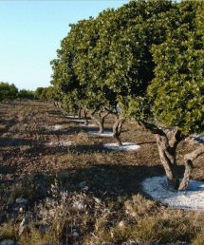

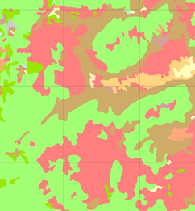
EMSN-001: a Non-RUSH Activation 2/5
Tailored Land Cover
Land Use was required CORINE Level3 for Overview maps and Level4 for Detailed Maps.
In addition, the delineation of the areas where Pistacia lentiscus var. Chia is cultivated was included as a separate class.
The specific class, Pistacia Lentiscus,
identification was performed with support of Ortophotoes
Pistacia
Lentiscus
Examples of Pistacia Lentiscus cultivation to be identified and classified in the Land-Use maps

Slide 36
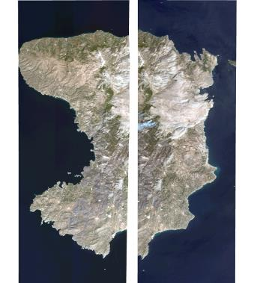
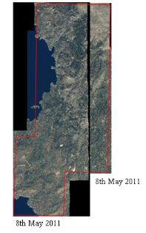
EMSN-001: a Non-RUSH Activation 5/5
Activation timeliness
28th Aug EMSN-001 service was triggered
26th Oct EMSN-001 activation starts
30th Oct – 06th Nov Availability of EO data (PRE and POST disaster)
20th Nov The 2 AOIs for detailed Maps were provided by JRC to Provider
5th Dec Overview maps were provided to JRC
13th Dec Detailed maps were provided to JRC
19th Dec After their quality check, JRC sent some updating requirements to the Provider that were implemented
04th Jan 2012 All the EMSN-001 Maps, Overview and Detailed, were provide to JRC and from JRC to the end User, as a final delivery
11th Jan 2012 the activation was closed

Slide 37

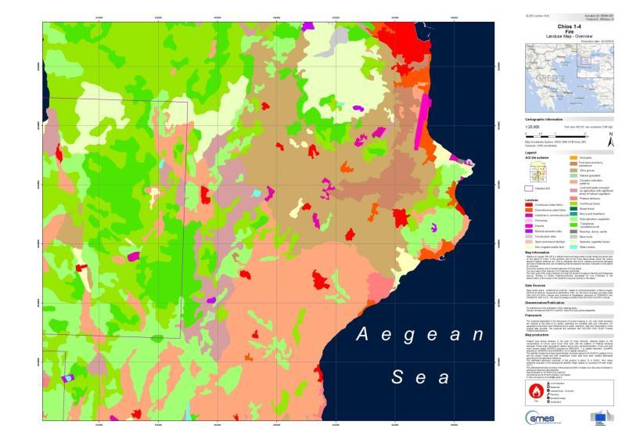
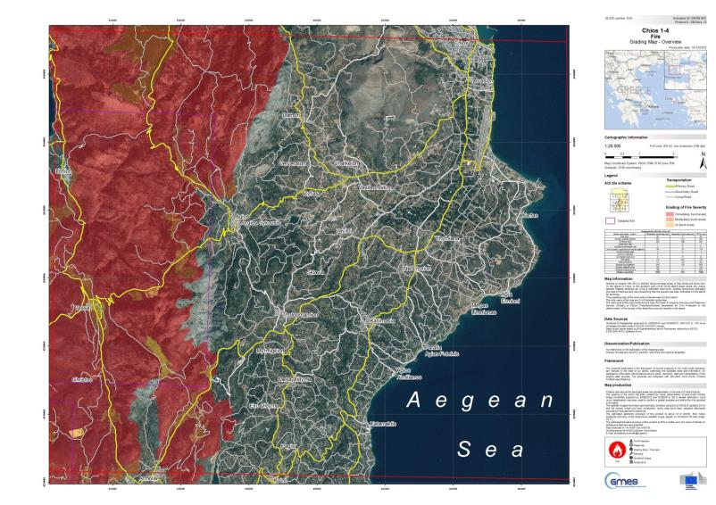
EMSN-001: a Non-RUSH Activation 3/5
Land Use Maps
Overview Map Examples
Delineation and Grading map with burnt area grading
in subcategories : “completely burnt” “partially burnt” “not burnt”
Reference Map

Slide 38
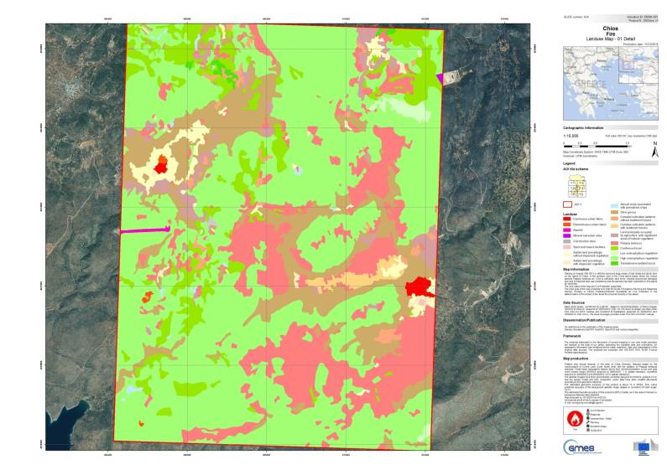
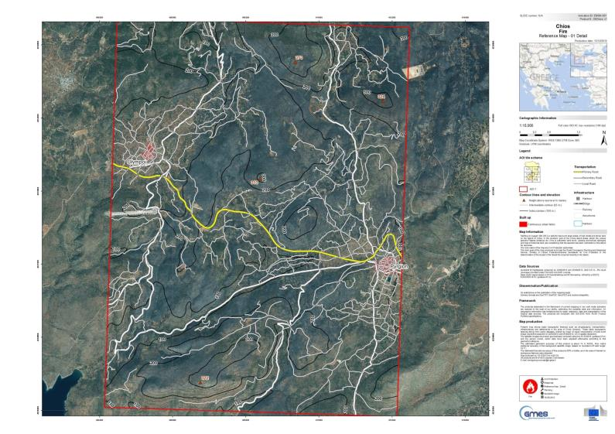
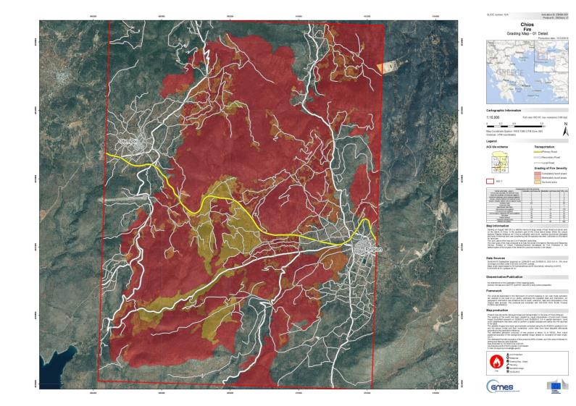
EMSN-001: a Non-RUSH Activation 4/5
Land Use Maps: Detailed AOI 2
Detailed Map Examples
Reference Maps: Detailed AOI 2
Delineation and Grading Maps: Detailed AOI 2

Slide 39
NON GIO RUSH Activations
Number | TITLE | USERS | Country | Disaster type
EMSN-001 | Forest Fire impact on Chios island, Greece | Greek emergency Planning and Response Service (Ministry of Civil Protection) | Greece | FIRE Damage Estimation
EMSN-002 | Population Density estimates and Land use database for Nyala (Sudan) | International Comity of Red Cross Genève (Switzerland) | DARFUR (Sudan) | estimation of needs for urban water network
EMSN-002 Part B | Population Density estimates and Land use database for Al Geneina and El Daein (Sudan) | International Comity of Red Cross Genève (Switzerland) | DARFUR (Sudan) | estimation of needs for urban water network
EMSN-003 | Monitoring of Ground deformation El Hierro (Canary island) | Spanish Ministry of Interior, centro de Coordination Operativa (CECOP) | Canary islands (Spain) | Volcanic and Seismic crisis : Interferometry for Ground deformation
EMSN-004 | TRIPLEX 2013 EU CP Exercise | German Federal Agency for Technical Relief (THW) International Division | Germany - Denmark | Exercise TRIPLEX (hurricane, flood,..)
EMSN-005 | TURANIS EU CP Exercise | Federal Ministry of the Interior | Austria | Flood
EMSN-006 | RESART 2013 CP Exercise | Ministry Interior of Czech Republic (General Directorate of the Fire Rescue Service) | Czech Republic | Exercise RESTART (black-out, windstorm)
EMSN-008 | TWIST 2013 EU CP Exercise | Italian Presidency of the Council of Ministries, DPC | Italy | Exercise TWIST (Landslide and tsunami)
EMSN-010 | Forest fire damage assessment Planning and Recovery Serra de Caramulo | ANPC - Autoridade Nacional de Proteccao Civil | Portugal | Fires - damage estimation of series of 8 fires

Slide 40
Operational Functional Contacts
The ECHO duty officers
Mail: ECHO-ERCC@ec.europa.eu
Phone: +32 229 21112
The Geospatial Emergency Management TEAM
Mail: gio-ems-nonrush@jrc.ec.europa.eu

Slide 41
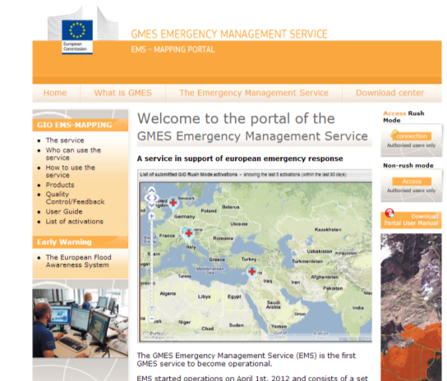
GIO EMS RUSH Portal
  The portal hosts the catalogue of map outputs and web services : http://emergency.copernicus.eu
Catalogue for dissemination of Quality reviewed outputs;
Platform to test alternative access to data, e.g. via WMS, WFS.

Slide 42
Thanks for your attention!
Notes:
Feedback forms will be distributed and people will be encouraged to complete them in this time.
Open floor up to questions.

Slide 43
Module 2: Live Demo of the GIO EMS
Overview of the portal and its generalities [15 mins]
Access to GIO EMS Portal (URL:http://emergency.copernicus.eu/mapping/)
  Use of Portal
  Activision Catalogue and Products download
PRESENTATION of GIO EMS USER GUIDE [10 mins]
Including SRF and UFF
PRESENTATION of Service Portfolio and Products characteristics [20 mins]
Printed maps package will be distributed through the audiences
Digital maps full resolution will be used to present details of Service products
  Product portfolio description
  Maps: Identification of Products needs and technical characteristics

Slide 44
Module 3: Scenario Exercise
Triggering the GIO EMS Service
Scenario Analysis and activation Exercise [1 hour 25 mins]
All the attendees will be provided with printed copy of:
  Disaster Scenario description
  Service Request Form
  User feedback Form
The exercise with the attendees will go through the following steps:
  Scenario Analysis – Need identification
  AOI selection – Area for Overview and Detailed maps identification
  Product selection and technical specification identification
  Access to the service – SRF compilation
  Service Triggering
  User Feed back – UFF compilation

Slide 45
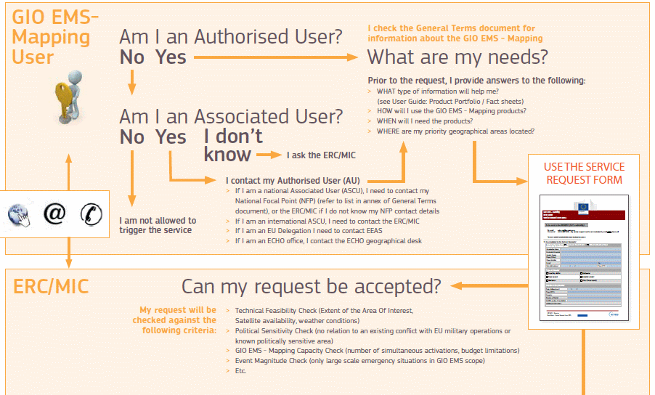
GIO EMS RUSH Portal
  The portal hosts the catalogue of map outputs and web services : http://emergency.copernicus.eu
Catalogue for dissemination of Quality reviewed outputs;
Platform to test alternative access to data, e.g. via WMS, WFS.

Slide 46
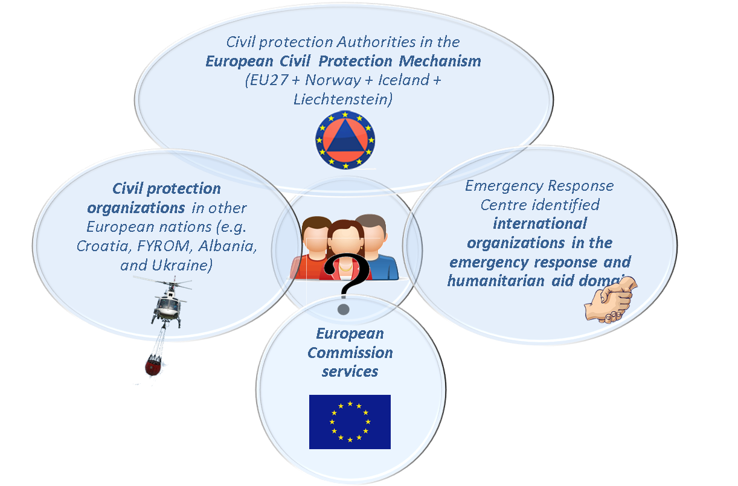
Authorized Users

